Slide 1

Medical Marijuana & CBC What Illnesses has it been proven to treat?
Michelle Houston

Slide 2
Analysis Overview
Looked into Raw data
Checked for null data
Formatting the initial analysis
Formatting questions
conclusions

Slide 3
Medical Marijuana & CBD STUDIES:
It has healing qualities.
More people use it for health purposes.
Legal in 33 states and Washington, D.C.
still A SCHEDULE 1 SUBSTANCE BY THE US FED’S

Slide 4
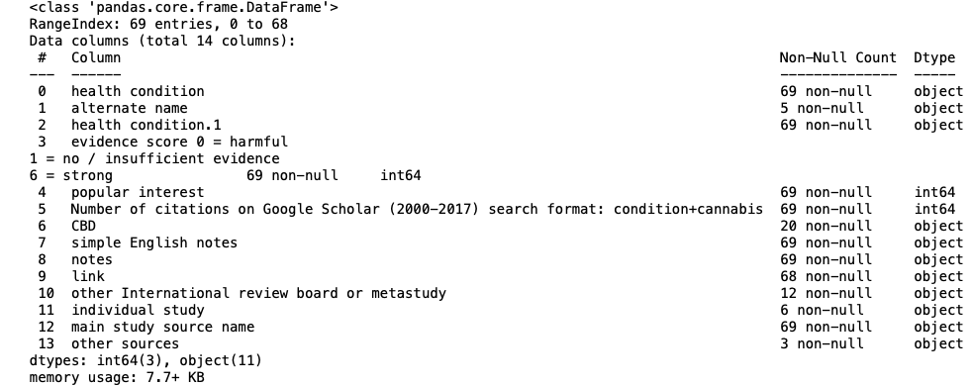
THE DATA TYPE
Looking at the data, there are 14 columns, that was observed.

Slide 5
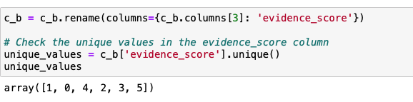
THE DATA TYPE
Checking the unique values in the evidence score column

Slide 6
Distribution of Evidence Score
NO STRONG EVIDENCE OF CANNABIS OR CBD WORK FOR HEALTH CONDITIONS.
VERY FEW CONIDTIONS HAVE A SCORE ABOVE 2, THERE IS A STRONG EVIDENCE INTENDED RESULT OF CANNABIS OR CBD TREATING MOST HEALTH CONDITIONS

Slide 7
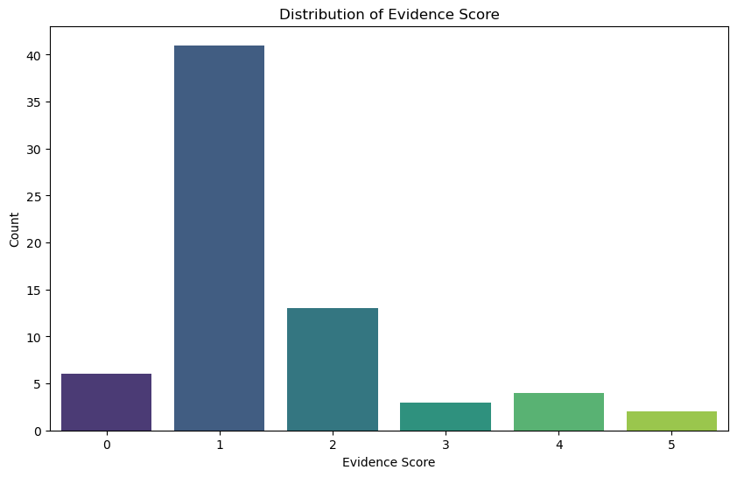
Distribution of Evidence Score Plot

Slide 8
Distribution of Health Condition Categories
Top 3
neurological – 19
Cancer -12
Mental – 9
It help patients to relax.

Slide 9
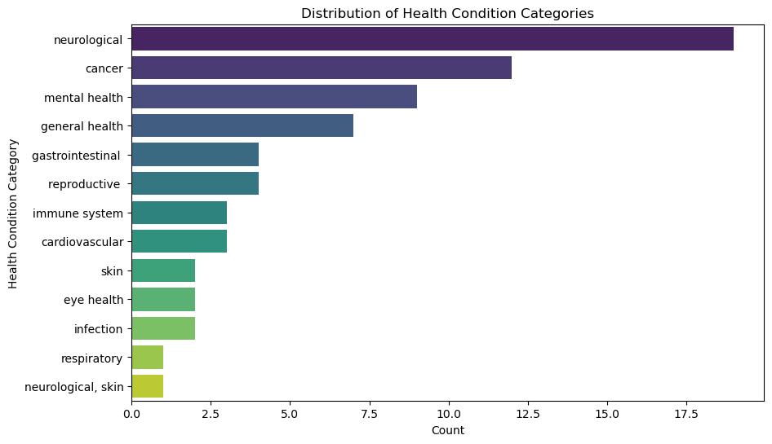
Distribution of Health Condition Categories Plot

Slide 10
Evidence Score by Popular Interest
Some things that many people like actually have little to no evidence to support them.
A group of things have a lot of people wanting them for treatment but not a lot of evidence to support their effectiveness (fewer than 1).
Only a few things have a lot of people wanting them and strong scientific proof that they work.

Slide 11
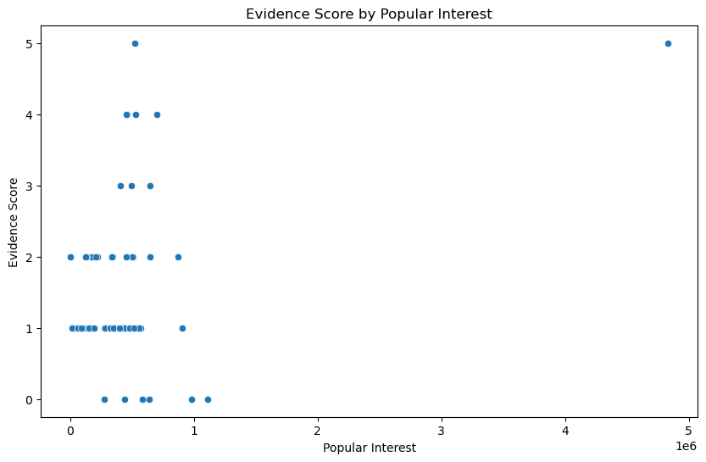
Evidence Score by Popular Interest Plot

Slide 12
CBD Involvement
Most situations listed in the data set do not make use of CBD for treatment, while a smaller subset of situations do incorporate CBD.

Slide 13
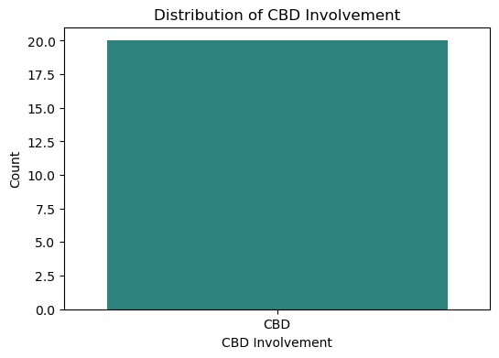
CBD Involvement Plot

Slide 14
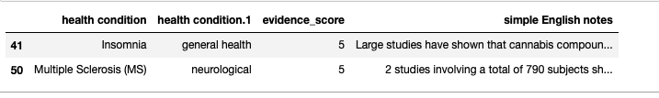
STRONG EVIDENCE
there are two health issues for which there's substantial proof (evidence_score >= 5) supporting the effectiveness of either cannabis or CBD

Slide 15
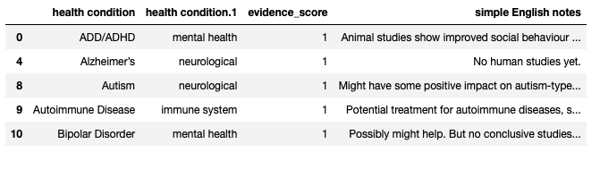
NO STRONG EVIDENCE
The following health ailments listed in the dataset either lack or have not enough supporting data (evidence_score = 1) on the effectiveness of cannabis or CBD.

Slide 16
The Analysis, Observations
Inadequate Strong Proof
Lack of or Weak Evidence:
Negative Consequences
Variation among Types
Popular Demand vs. Scientific Proof
CBD Use: The vast majority of conditions in the dataset do not involve CBD in their treatment, with only a few exceptions.

Slide 17
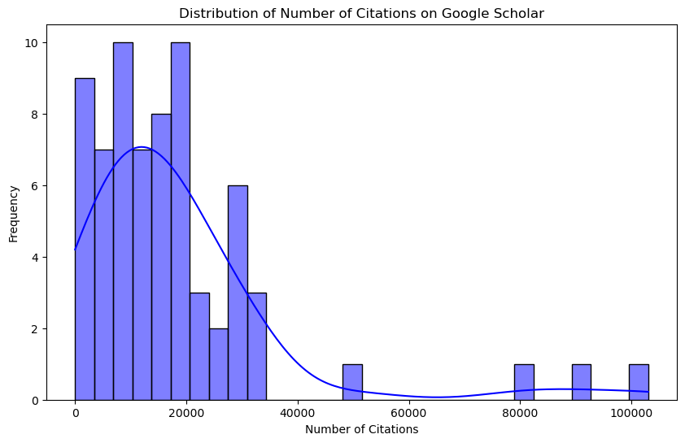
Distribution of Number of Citations on Google Scholar
The chart illustrates how the count of references on Google Scholar is spread out across articles discussing various health conditions and cannabis.

Slide 18
Distribution of Number of Citations on Google Scholar
It's distinctly slanted to the right, showing that most conditions are cited in very few papers, whereas a select few have received significantly more citations. This hints at a broad disparity in the scientific community's interest and research output across different health issues tied to cannabis.
The chart illustrates how the count of references on Google Scholar is spread out across articles discussing various health conditions and cannabis.

Slide 19
CONCLUSIONS
Conclusive Proof: Research strongly supports the use of cannabis or CBD for just a select few health issues, mainly Insomnia and MS.
Incomplete Proof: Most of the health conditions listed do not have conclusive proof regarding the effectiveness of cannabis or CBD.
Serious Risks: Health issues like Adolescence, Asthma, and Depression are linked to serious risks with the use of cannabis or CBD.
Differences Among Types: The proof of effectiveness for cannabis or CBD varies greatly within different types of health conditions

Slide 20
CONCLUSIONS CONTINUE
Public Demand vs. Research Proof: There's no obvious link between what's popular and the robustness of research in support of cannabis or CBD's effectiveness.
CBD Use: A limited number of health conditions benefit from the use of CBD for treatment.

Slide 21
CONCLUSIONS CONTINUE
Research References: The count of references in Google Scholar for studies about the condition and its relation to cannabis or CBD ranges from low to high, reflecting various research levels and interests in the scientific community for different health conditions and cannabis-related research.
Differences Among Types: The proof of effectiveness for cannabis or CBD varies greatly within different types of health conditions

Slide 22
Thank you
Michelle Houston

